Slide 1


Summer Internship at Future Way Institute of Multimedia, Surat
Department of Computer Science and Engineering
S.N. Patel Institute of Technology and Research Centre
Umrakh, Bardoli
Guided by Presented by
Prof. Jahnavi A. Desai Sahil Bharatkumar Kayasth
Internal Guide (220490131026)

Slide 2

Outline:
Introduction
Objectives of Internship
Problem Statement & Goal
Problem, Purpose & Objectives
Steps for RBAC Creation
Login Page & Dashboard Layout
Challenges & Learnings
Conclusion
References

Slide 3

Company’s Introduction:
Company’s Description:
Future Way Multimedia is a leading IT Company + learning Institute of Surat. Their main is work is to provide IT System training and support to small and big IT companies.
It functions under the name Future Way Institute of Multimedia and is based in Surat, Gujarat.
It aims to connect organizations, non-profits, and public entities to boost software development efforts across sectors like education and livelihoods.
My role as intern:
Designation: Web developer Intern
Duration: 4 Weeks
Mode of work: Offline

Slide 4

Objectives of Internship:
Primary Objectives:
Learn how to use Laravel’s features like Blade templates, routing, and controllers effectively.
Understand how to connect Laravel applications with phpMyAdmin for managing data.
Explore and apply the Laravel Spatie package for managing roles and permissions.
Project’s Goal:
To create a secure Role-Based Access Control system where users have different permissions based on their roles.
Ensure that each role (Admin, School, Teacher, Student) can only access the data and actions allowed for them.
Provide a simple and user-friendly interface using Blade templates.

Slide 5

Problem Statement & Goal:
Statement:
Without proper access control, all users may access or modify sensitive data, leading to security risks. A system was needed to give specific permissions based on user roles.
Goal:
To build a secure RBAC system in Laravel where each role has defined permissions, ensuring data security and a role-specific experience.

Slide 6
Problem, Purpose & Objectives:
Problem:
Anyone could access or change data without restrictions.
No clear separation of permissions for different types of users.
Risk of data misuse and security breaches.
Purpose:
To create a secure system where each user has access only to what they need.
To ensure smooth management of data based on user roles.
Objectives:
Implement Role-Based Access Control (RBAC) using Laravel.
Use Laravel Spatie to create and assign roles & permissions.
Provide separate dashboards and actions for Admin, School, Teacher, and Student.
Objectives
Purpose
Problem

Slide 7
Steps for RBAC Creation:
1. Setup Laravel Project
2. Database Connection
3. Create Users Table
4. Install Spatie Packege
5. Create Roles & Permissions
6. Routing Setup
7. Blade Templates
8. Role Based Access
9. Testing

Slide 8
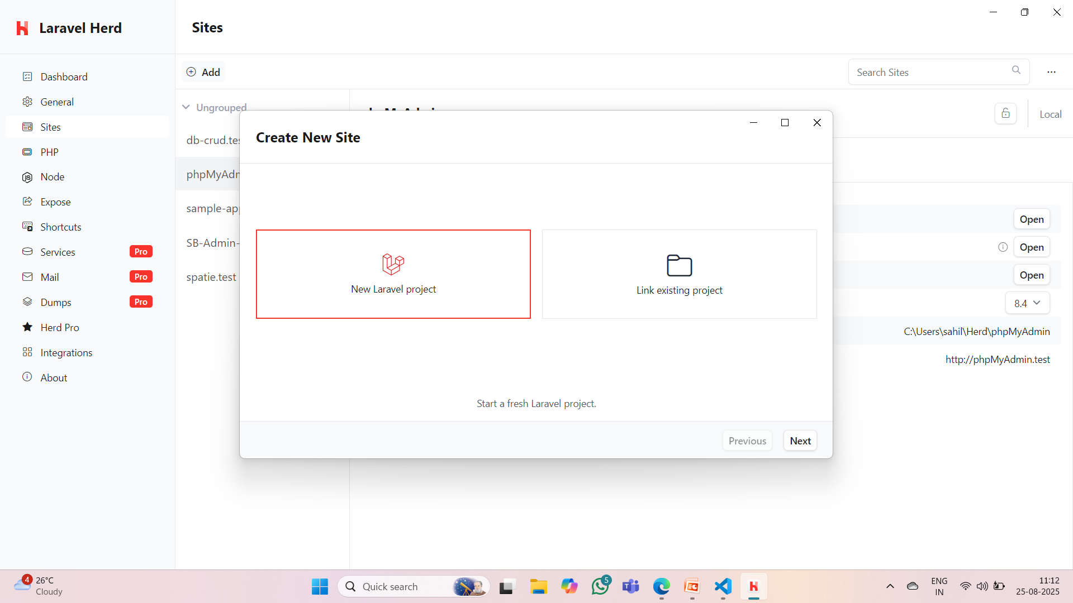
Steps for RBAC Creation(Conti…):
Step – 1: Set up Laravel Project

Slide 9
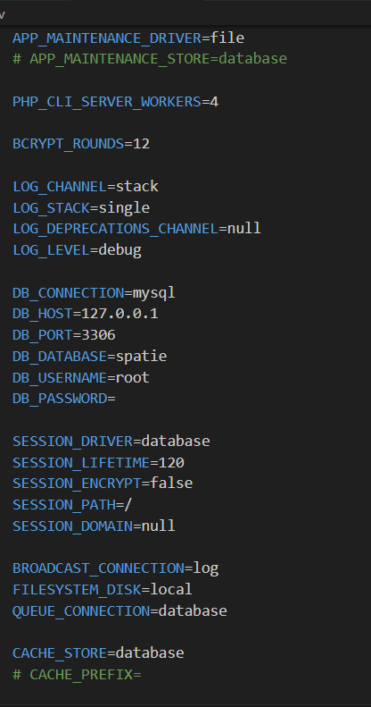
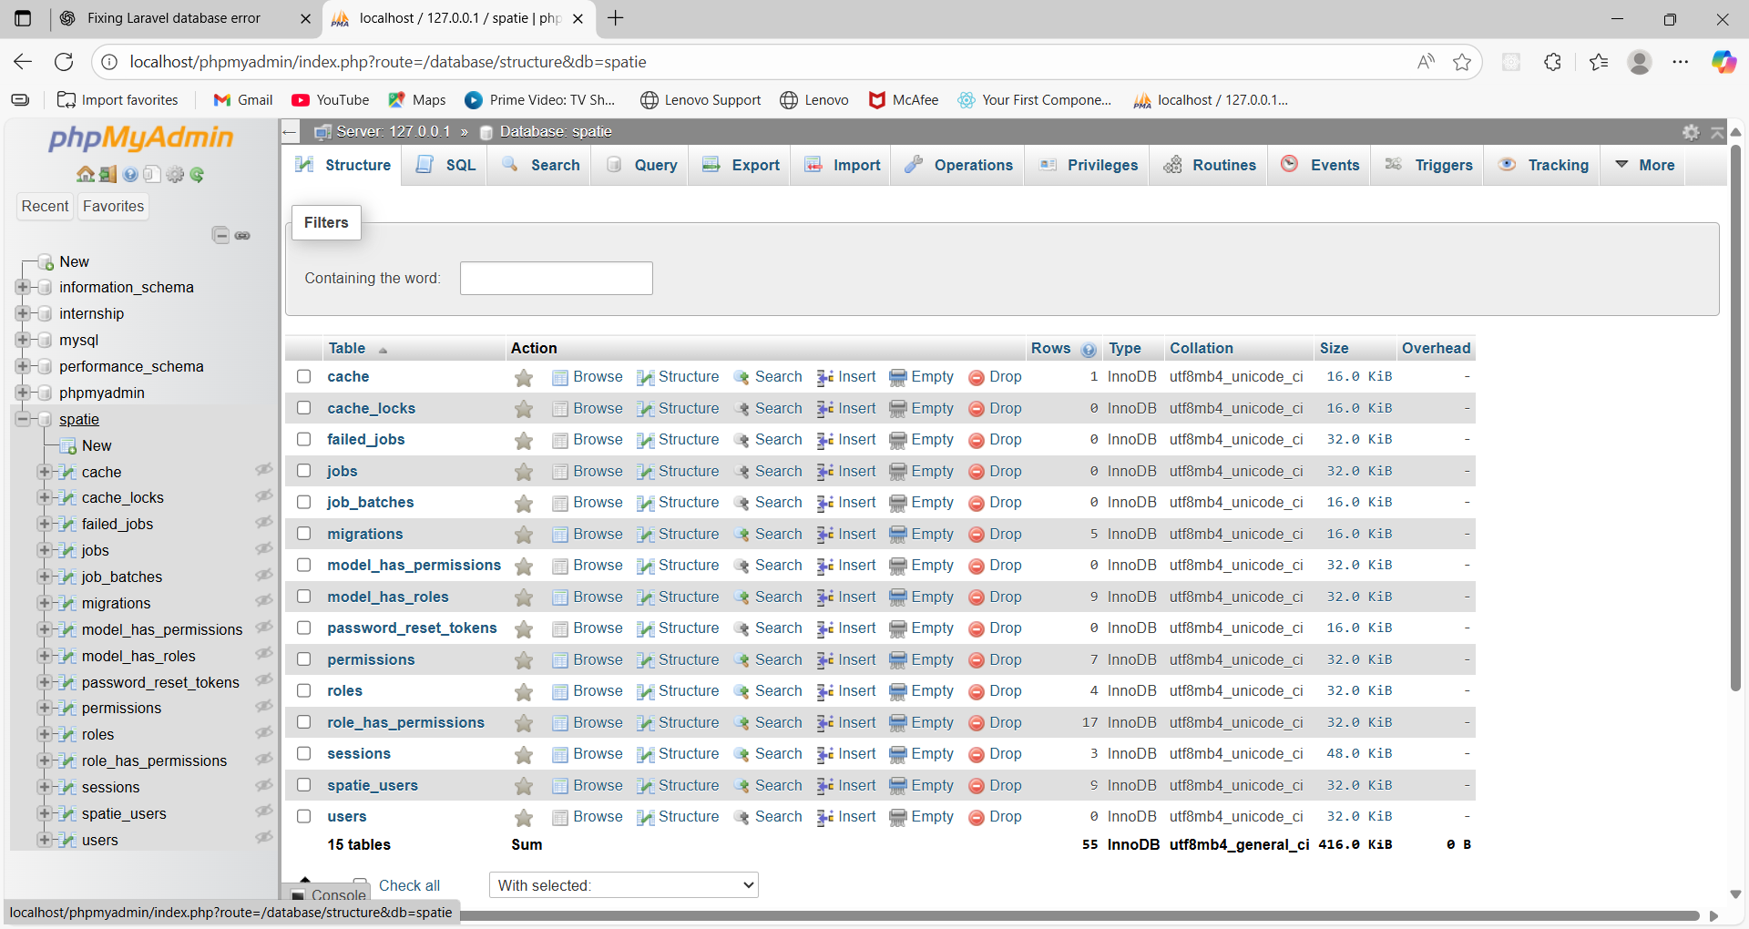
Steps for RBAC Creation(Conti…):
Step – 2: Database Connection

Slide 10
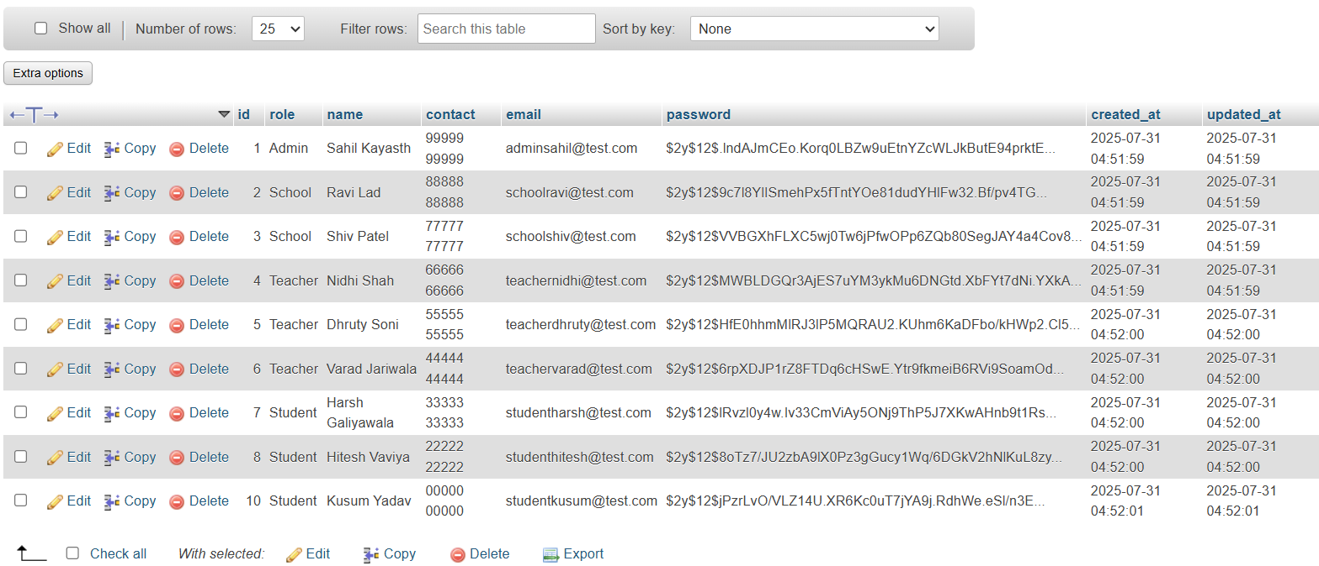
Steps for RBAC Creation(Conti…):
Step – 3: Create Users Table

Slide 11
Steps for RBAC Creation(Conti…):
Step – 4: Install Spatie Package
Command to install Spatie Package is:
“composer require spatie/laravel-permission”.
After installation, publish & config the migration files with:
“php artisan vendor:publish --provider="Spatie\Permission\PermissionServiceProvider” ”.
Then run the final command: “php artisan migrate”.

Slide 12
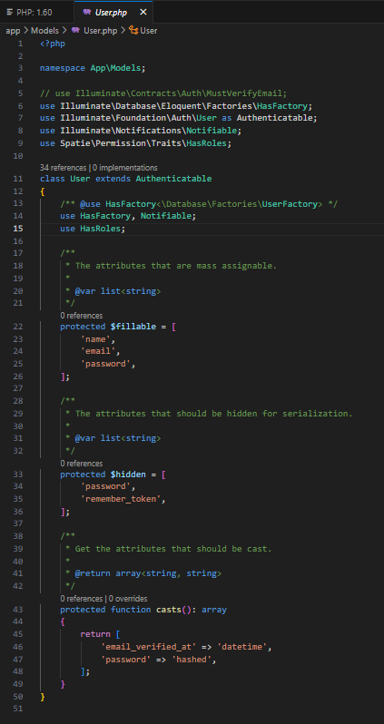
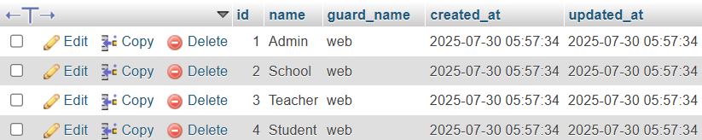
Steps for RBAC Creation(Conti…):
Step – 5: Create Roles & Permissions
Add HasRoles trait in User.php model.
Create Roles:
$AdminUser = SpatieUser::create([
'name' => 'Sahil Kayasth',
'email'=> 'adminsahil@test.com',
'contact' => '99999 99999',
'role' => 'Admin',
'password' => Hash::make('adminsk123'),
]);

Slide 13
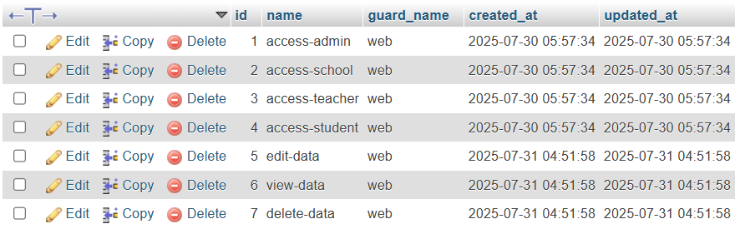
Steps for RBAC Creation(Conti…):
Step – 5: Create Roles & Permissions (Conti…)
Create Permissions:
“$AdminPermission = Permission::firstOrCreate(['name' => 'access-admin']);

Slide 14
Steps for RBAC Creation(Conti…):
Step – 5: Create Roles & Permissions (Conti…)
Permissions to roles:
$Admin->givePermissionTo([$AdminPermission, $SchoolPermission, $TeacherPermission, $StudentPermission, $EditPermission, $ViewPermission, $DeletePermission]);
”.

Slide 15
Steps for RBAC Creation(Conti…):
Step – 6: Routing Setup:
Assign routes of blade templates & CRUD operations.
“Route::get('/login', [AuthController::class, 'showLogin'])->name('login');
”.
Step – 7: Blade Templates:
Create different blade templates like login, dashboard, view, etc.
Note: blade templates are must saved with extension “.blade.php” i.e.
Login.blade.php .
Step – 8: Role Based Access:
Our Role Based Access is ready.
Step – 9: Testing:
Try to login with different roles and their credentials you created.

Slide 16
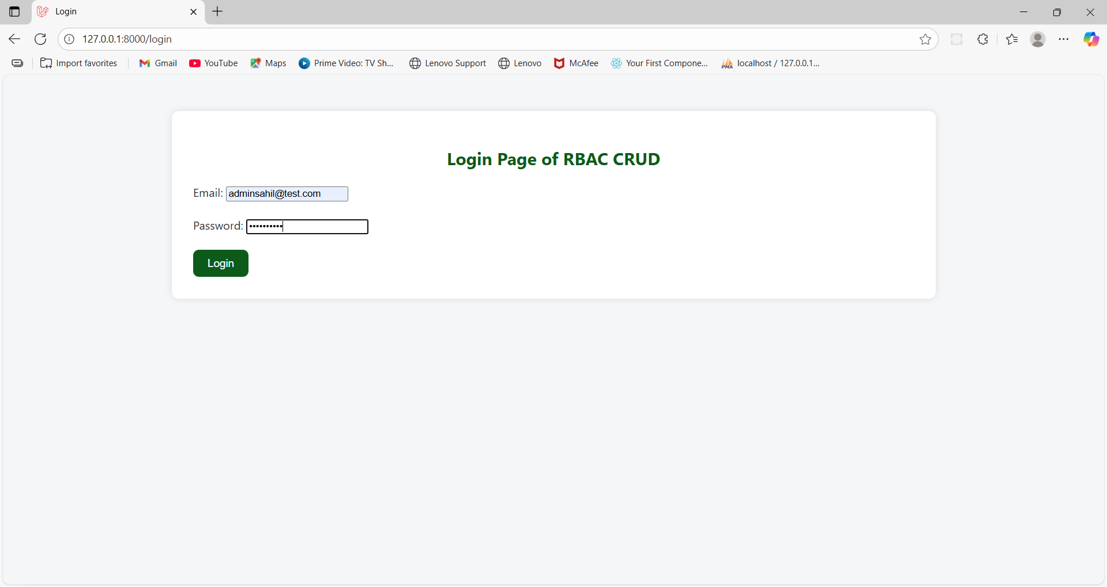
Login Page and Dashboard Layout:
RBAC Login Page:-
Here different roles i.e. Admin, School, Teacher, Student can login by entering their passwords.

Slide 17
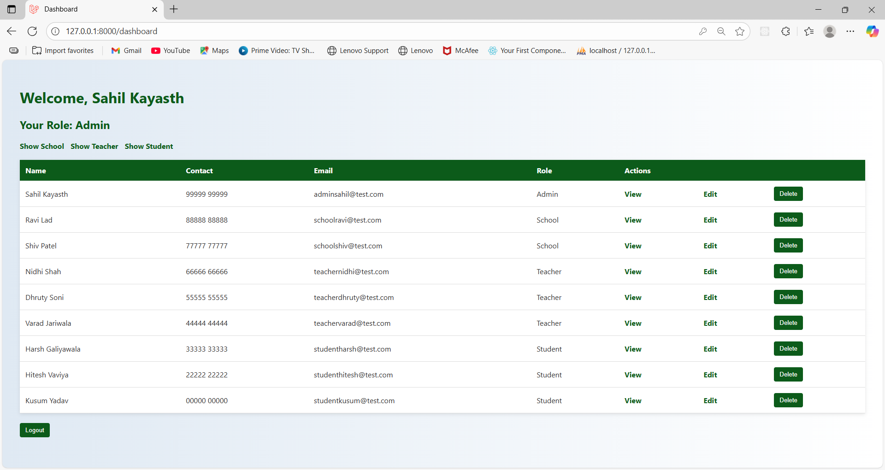
Login Page and Dashboard Layout(Conti…):
RBAC Dashboard:-
Admin can see data of all roles(school, teacher, student),
School can see data of school teacher & student.

Slide 18
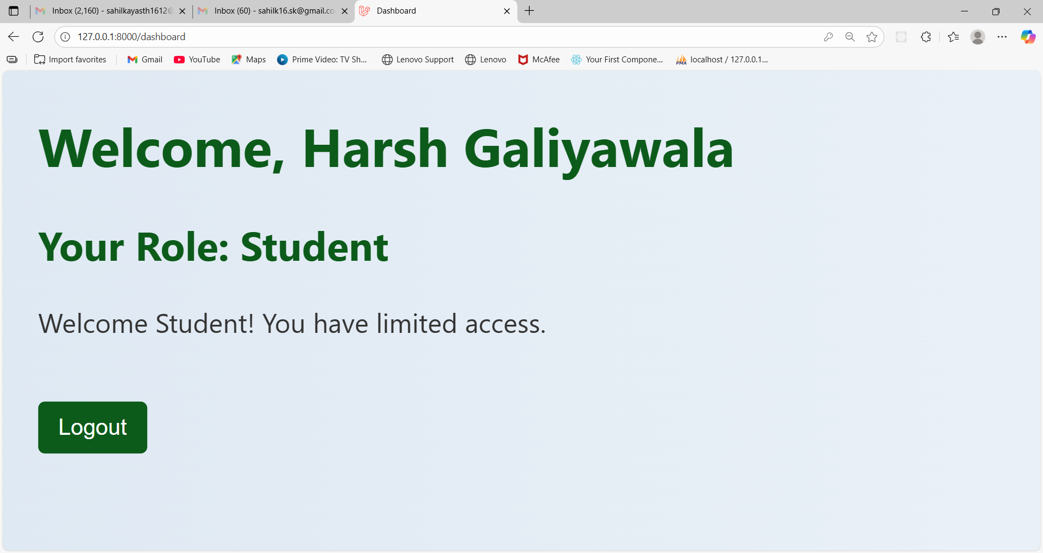
Login Page and Dashboard Layout(Conti…):
RBAC Dashboard:-
Teacher can see data of teacher & student, Student can’t see any data.

Slide 19
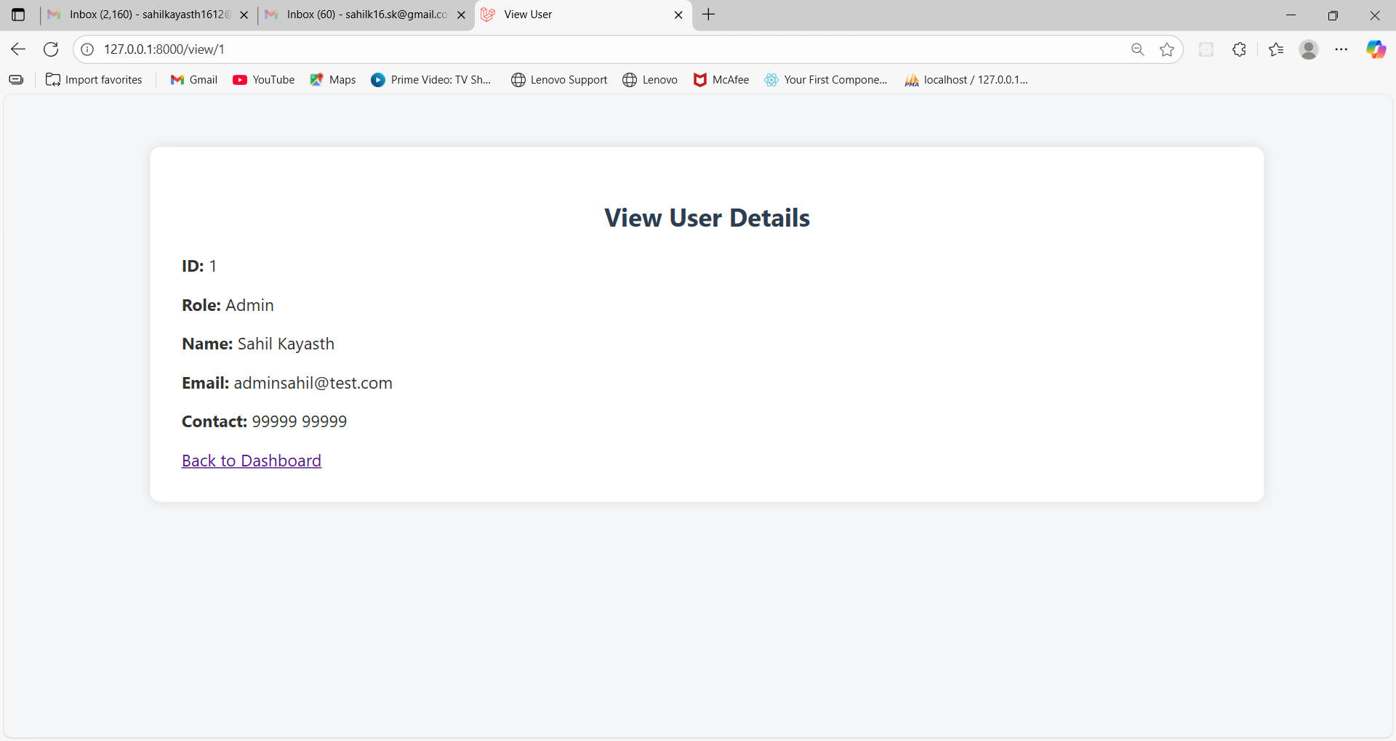
Login Page and Dashboard Layout(Conti…):
RBAC Dashboard (View Page):-

Slide 20
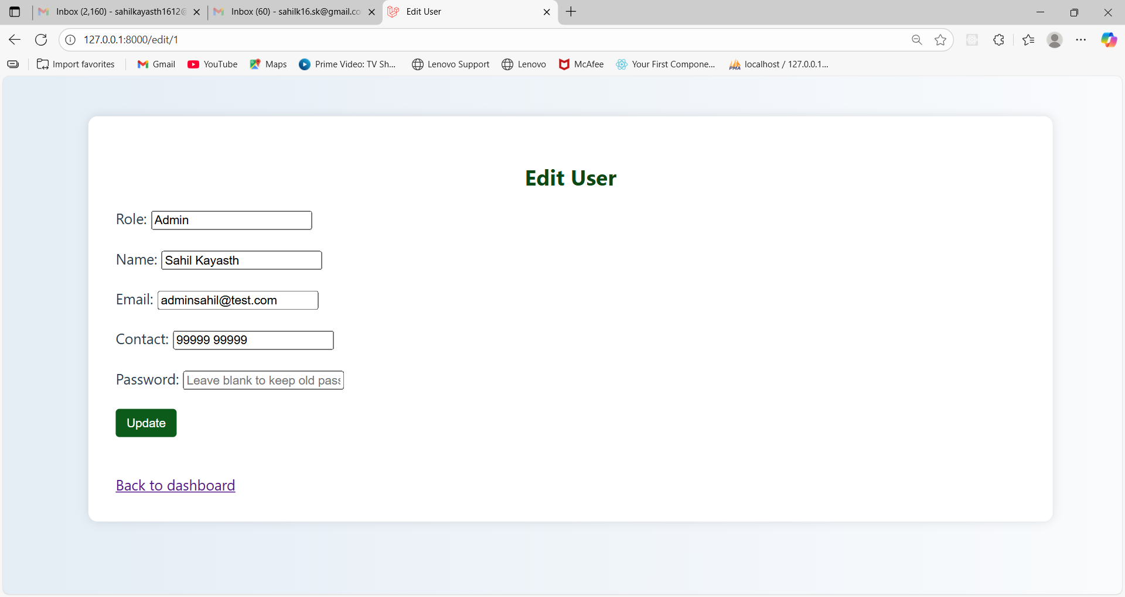
Login Page and Dashboard Layout(Conti…):
RBAC Dashobard (View Page):-

Slide 21
Challenges and Learnings:
Challenges:
Understanding how Laravel Spatie handles roles and permissions.
Configuring Blade templates to show or hide content based on user roles.
Setting up database relationships for storing roles, permissions, and users.
Ensuring correct routing and access control so each role sees only allowed pages.
Debugging issues when permissions were not applied as expected.
Learnings:
Gained practical knowledge of Role-Based Access Control (RBAC) in Laravel.
Learned how to use Spatie package for creating and assigning roles/permissions.
Improved understanding of Laravel routing, Blade views, and database connections.
Learned how to restrict actions (view, edit, delete) based on user roles.
Enhanced problem-solving and debugging skills during implementation.

Slide 22
Conclusion:
Our internship project on Role-Based Access Control (RBAC) helped us understand how to manage user access efficiently in Laravel applications. By using the Spatie package, we successfully implemented a system where different roles have specific permissions, ensuring security and organized access to data. This project enhanced our skills in routing, database connectivity, Blade templates, and permission handling. Overall, it was a valuable learning experience that strengthened both our technical knowledge and problem-solving abilities.

Slide 23
References:
[1] Laravel Official Website. [Online]. Avaliable: Laravel - The PHP Framework For Web Artisans
[2] Laravel Spatie Offical Website . [Online]. Avaliable : Using Permissions via Roles | laravel-permission | Spatie

Slide 24
Thank You

